Slide 1
THE IS-LM MODEL
PRINCIPLES OF MACRO ECONOMICS 2
ECONA 202

Slide 2
The origin of the IS-LM model
The IS-LM model was developed in 1937 by Nobel laureate Sir John Hicks, who intended to interpret the ideas of Keynes in the book, The General Theory of Employment, Interest, and Money, by graphs.

Slide 3
The meaning of the IS-LM model
The IS-LM model represents the simultaneous equilibrium of the goods and services market and the asset market.
I represents investment, S represents saving, L represents real money demand, and M represents money supply. During equilibrium, I=S, L=M.

Slide 4
The IS-LM model
This model uses graphs on the coordinates of the real interest rate, r, and the real income, Y, to represent the combinations of the real interest rate and the real income that give rise to the equilibria in the goods market (the IS curve) and in the asset market (the LM curve).

Slide 5
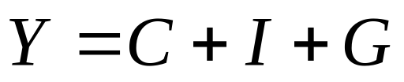
The IS curve
The IS curve represents all the combinations of the real interest rate and the real income that equate the demand for goods and services and the supply of goods and services ( the equilibrium of goods and services market), given other things being equal.
( in a closed economy)

Slide 6
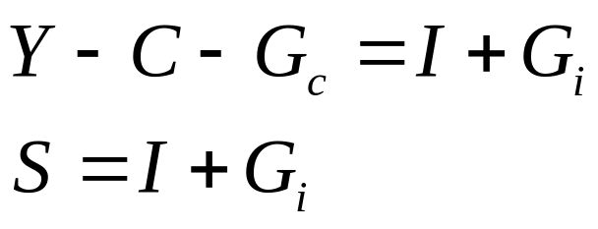
The IS curve
The goods market equilibrium can be expressed as
National saving equals total domestic investment.

Slide 7
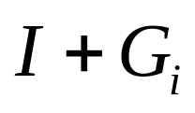
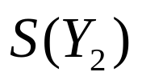
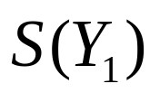


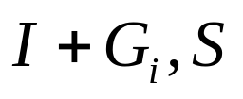
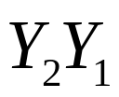

IS curve
r

Slide 8
The slope of the IS curve
When the real income is increased, the national saving curve will move to the right. In order to restore the equilibrium in the goods market, the real interest rate must fall to stimulate the investment.
The IS curve is a downward slopping curve. (negative slope)

Slide 9
Factors that shift the IS curve
Given the real income level, any factor that will make the equilibrium real interest rate to rise (fall) will shift the IS curve to the right (left).

Slide 10
Factors that shift the IS curve
Expected future marginal product of capital
Effective tax rate on capital
Government investment
Expected future output
Wealth
Government consumption
Taxes.

Slide 11
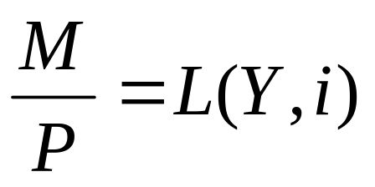
The LM curve
The LM curve represents all the combinations of the real interest rate and the real income that equate the demand for real money and the supply of real money ( the equilibrium of the money market), given other things being equal.

Slide 12

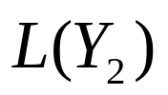
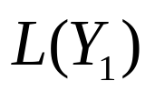

LM curve

Slide 13
The slope of the LM curve
When the real income level increases, the real money demand will increase too. Given the real money supply, the equilibrium real interest rate will rise.
The LM curve is an upward slopping curve ( positive slope).

Slide 14
Factors that shift the LM curve
Given the real income level, any factor that will make the equilibrium real interest rate to rise (fall) will shift the LM curve to the left (right).

Slide 15
Factors that shift the LM curve
Nominal money supply
The price level
Wealth
Nominal interest rate on nonmoney assets
Expected inflation
Relative risk of nonmoney assets to money assets.
Relative liquidity of nonmoney assets to money assets.

Slide 16
The IS-LM model
We can put the IS curve and the LM curve together to determine the aggregate demand for goods and services, given the price level.
For a fixed price level, the intersection of the IS and the LM curves determines the equilibrium real income of an economy in the short run.

Slide 17

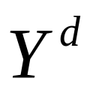
LM curve
IS curve

